Slide 1



SESSION NAME HERE
SORTING AND SEARCHING

Slide 2


Foundational Sessions Housekeeping
The use of disrespectful language is prohibited in the questions, this is a supportive, learning environment for all - please engage accordingly. (FBV: Mutual Respect.)
No question is daft or silly - ask them!
There are Q&A sessions midway and at the end of the session, should you wish to ask any follow-up questions. Moderators are going to be answering questions as the session progresses as well.
If you have any questions outside of this lecture, or that are not answered during this lecture, please do submit these for upcoming Open Classes. You can submit these questions here:
SE Open Class Questions or DS Open Class Questions

Slide 3
Foundational Sessions Housekeeping cont.
For all non-academic questions, please submit a query: www.hyperiondev.com/support
Report a safeguarding incident: www.hyperiondev.com/safeguardreporting
We would love your feedback on lectures: Feedback on Lectures

Slide 4


Reminders!
Guided Learning Hours
By now, ideally you should have 7 GLHs per week accrued. Remember to attend any and all sessions for support, and to ensure you reach 112 GLHs by the close of your Skills Bootcamp.
CONFIDENTIAL

Slide 5
Progression Criteria
✅ Criterion 1: Initial Requirements
Complete 15 hours of Guided Learning Hours and the first four tasks within two weeks.
✅ Criterion 2: Mid-Course Progress
Software Engineering: Finish 14 tasks by week 8.
Data Science: Finish 13 tasks by week 8.
✅ Criterion 3: Post-Course Progress
Complete all mandatory tasks by 24th March 2024.
Record an Invitation to Interview within 4 weeks of course completion, or by 30th March 2024.
Achieve 112 GLH by 24th March 2024.
✅ Criterion 4: Employability
Record a Final Job Outcome within 12 weeks of graduation, or by 23rd September 2024.
CONFIDENTIAL

Slide 6


Graphs Topics
Definitions
Sorting
Searching

Slide 7

Definitions
Searching Algorithms are essential tools used to locate specific items within a collection of data. These algorithms are designed to efficiently navigate through data structures to find the desired information, making them fundamental in various applications such as databases, web search engines, and more. Source
Sorting Algorithms are used to rearrange a given array or list of elements according to a comparison operator on the elements. The comparison operator is used to decide the new order of elements in the respective data structure. Source

Slide 8

Sorting: Bubble Sort
Bubble Sort is the simplest sorting algorithm that works by repeatedly swapping the adjacent elements if they are in the wrong order.
Steps:
Traverse from left and compare adjacent elements and the higher one is placed at right side.
In this way, the largest element is moved to the rightmost end at first.
This process is then continued to find the second largest and place it and so on until the data is sorted.
Notes:
Worked Example in class!

Slide 9
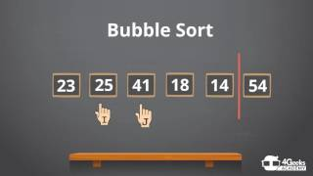
Sorting: Bubble Sort
Notes:
Worked Example in class!

Slide 10
Sorting: Selection Sort
Selection sort is a sorting algorithm that works by repeatedly selecting the smallest (or largest) element from the unsorted portion of the list and moving it to the sorted portion of the list.
Steps:
Assign the minimum value to array index 0
Search Smallest element in an array
Swap with value at the location of minimum value
Increment minimum value to point next element
Repeat until the array is sorted
Notes:
Worked Example in class!

Slide 11
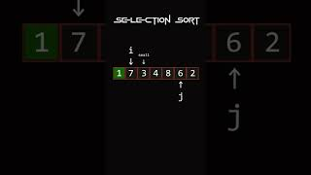
Sorting: Selection Sort
Notes:
Worked Example in class!

Slide 12
Sorting: Insertion Sort
Insertion sort is a sorting algorithm that works by splitting the array into a sorted and an unsorted part. Values from the unsorted part are picked and placed in the correct position in the sorted part.
Steps:
If it is the first element, it is already sorted. return 1;
Pick next element
Compare with all elements in the sorted sub-list
Shift all the elements in the sorted sub-list that is greater than the value to be sorted
Insert the value
Repeat until list is sorted
Notes:
Worked Example in class!

Slide 13
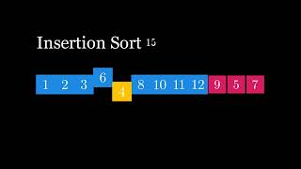
Sorting: Insertion Sort
Notes:
Worked Example in class!

Slide 14
Sorting: Merge Sort
Merge sort is a sorting algorithm that works by dividing an array into smaller subarrays, sorting each subarray, and then merging the sorted subarrays back together to form the final sorted array.
Steps:
Divide the unsorted list into n sublists, each containing one element (a list of one element is considered sorted).
Repeatedly merge sublists to produce new sorted sublists until there is only one sublist remaining. This will be the sorted list.
Notes:
Worked Example in class!

Slide 15
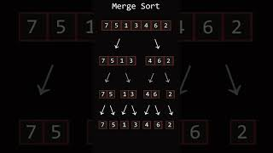
Sorting: Merge Sort
Notes:
Worked Example in class!

Slide 16
Sorting: Quick Sort
QuickSort is a sorting algorithm based on the Divide and Conquer algorithm that picks an element as a pivot and partitions the given array around the picked pivot by placing the pivot in its correct position in the sorted array.
Steps:
Choose a value in the array to be the pivot element.
Order the rest of the array so that lower values than the pivot element are on the left, and higher values are on the right.
Swap the pivot element with the first element of the higher values so that the pivot element lands in between the lower and higher values.
Do the same operations (recursively) for the sub-arrays on the left and right side of the pivot element.
Notes:
Worked Example in class!

Slide 17
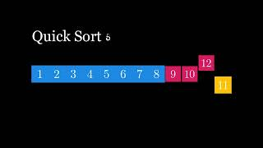
Sorting: Quick Sort
Notes:
Worked Example in class!

Slide 18
Searching: Linear Search
Linear Search is defined as a sequential search algorithm that starts at one end and goes through each element of a list until the desired element is found, otherwise the search continues till the end of the data set.
Steps:
Every element is considered as a potential match for the key and checked for the same.
If any element is found equal to the key, the search is successful and the index of that element is returned.
If no element is found equal to the key, the search yields “No match found”.
Notes:
Worked Example in class!

Slide 19
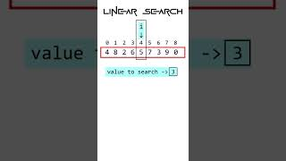
Searching: Linear Search
Notes:
Worked Example in class!

Slide 20
Searching: Binary Search
Binary Search is defined as a searching algorithm used in a sorted array by repeatedly dividing the search interval in half. The idea of binary search is to use the information that the array is sorted and reduce the time complexity to O(log N).
Steps:
Next Slide
Notes:
Worked Example in class!

Slide 21
Searching: Binary Search
Steps:
Divide the search space into two halves by finding the middle index “mid”.
Compare the middle element of the search space with the key.
If the key is found at middle element, the process is terminated.
If the key is not found at middle element, choose which half will be used as the next search space.
If the key is smaller than the middle element, then the left side is used for next search.
If the key is larger than the middle element, then the right side is used for next search.
This process is continued until the key is found or the total search space is exhausted.
Notes:
Worked Example in class!

Slide 22
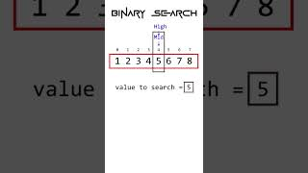
Searching: Binary Search
Notes:
Worked Example in class!

Slide 23
Order of Complexity
 | Algorithms | Best | Average | Worst | Space
Sorting | Bubble Sort | O(n) | O(n²) | O(n²) | O(1)
 | Selection Sort | O(n²) | O(n²) | O(n²) | O(1)
 | Insertion Sort | O(n) | O(n²) | O(n²) | O(1)
 | Merge Sort | O(n log(n)) | O(n log(n)) | O(n log(n)) | O(n)
 | Quick Sort | O(n log(n)) | O(n log(n)) | O(n²) | O(log(n))
Searching | Linear Search | O(1) | O(n) | O(n) | O(1)
 | Binary Search | O(1) | O(log(n)) | O(log(n)) | O(1)
Notes:
Worked Example in class!

Slide 24


Thank you
for joining us
Take regular breaks
Stay hydrated
Avoid prolonged screen time
Practice good posture
Get regular exercise
“With great power comes great responsibility”

Slide 25


Questions and Answers
Questions around Sorting And Searching

